Slide 1
Improvements in Taste Reactivity Quantification/Classification
Jessica Jones, Adam Gordon-Fennell, Garret Stuber
Notes:
So today I will be talking about quantifying and classifying taste reactivity behavior with machine learning

Slide 2
Background

Slide 3
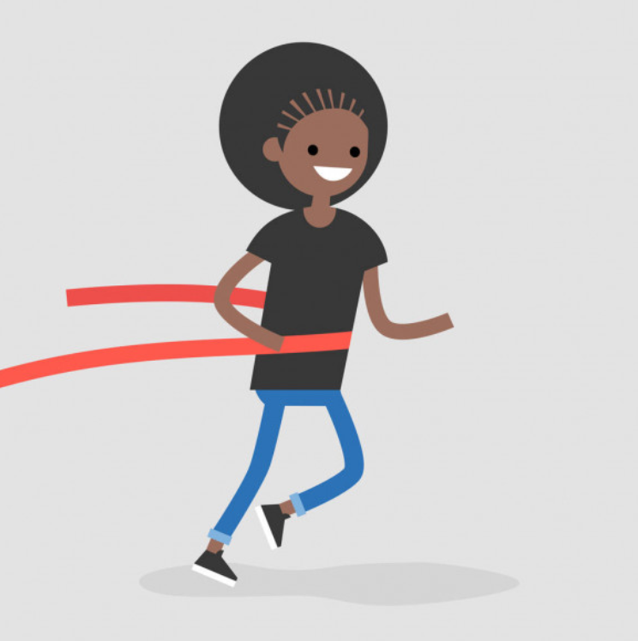
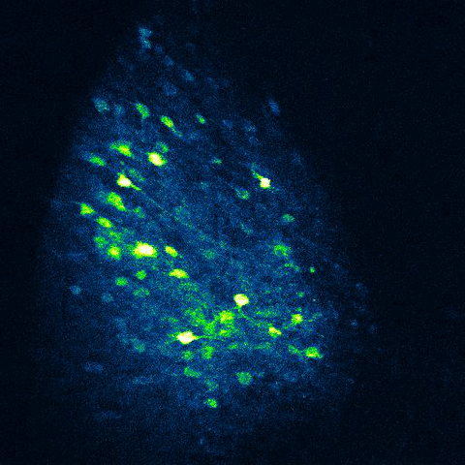
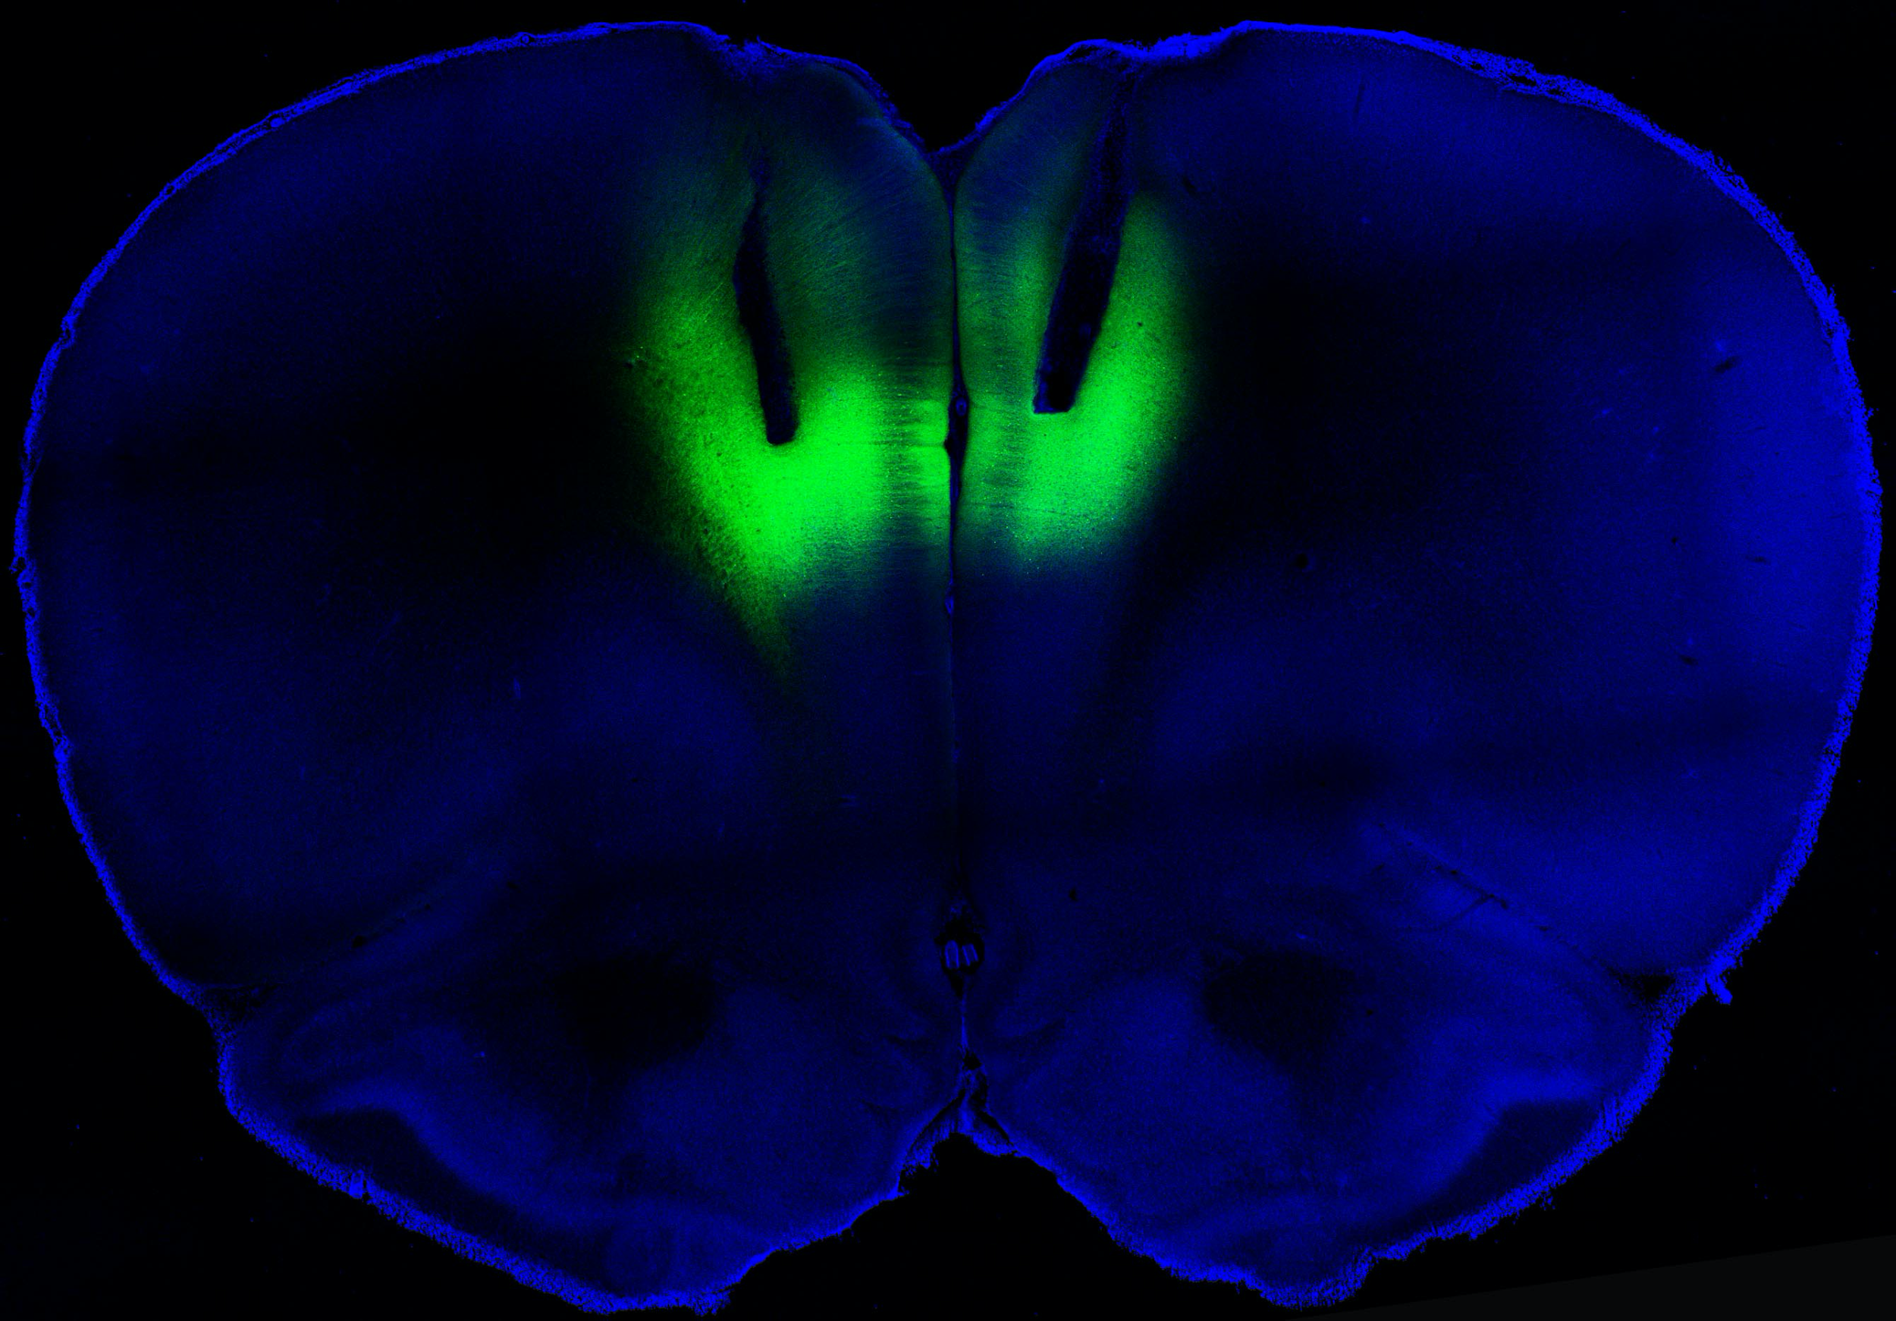
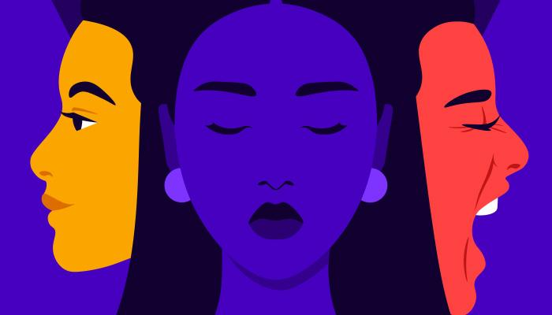
The Stuber Lab
Example image: Optogenetic stimulation of prelimbic cortex w/ laser pulse and subsequent calcium imaging
MOTIVATION
CORTICAL INFORMATION PROCESSING
DISORDER PHENOTYPE
Notes:
The stuber lab’s overall goal is to better understand how our experiences are encoded in the brain, and how this influences
*click* motivation behavior.
The lab also wants to investigate what encoding mechanisms change *click* in psychiatric disorders like addiction, dysregulated eating, and anxiety in regions like the prelimbic cortex shown here.

Slide 4
The Stuber Lab
How do we link?
?
DISORDER PHENOTYPE
INFORMATION PROCESSING
Notes:
This investigation is important because one of the major hindrances to studying mechanisms of emotion,
*click* is how to link observable behavior with internal states.

Slide 5
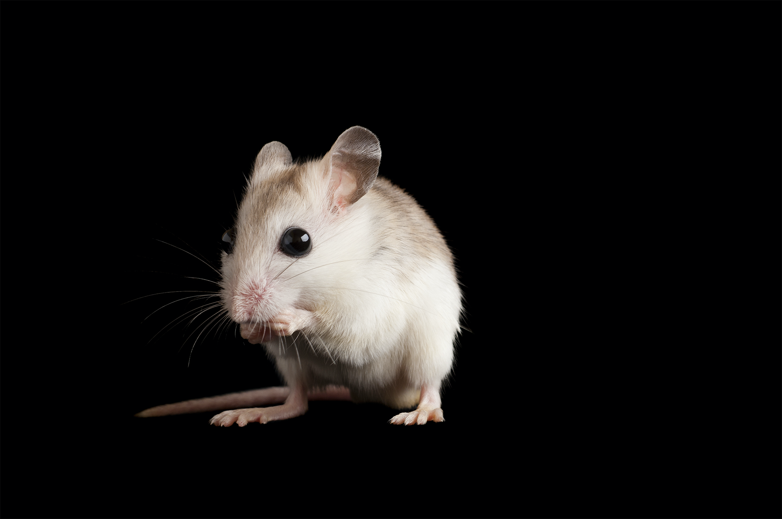
The Stuber Lab
Taste
reactivity
?
INFORMATION PROCESSING
Notes:
And specifically with mice, given that mice are nonverbal, it’s even harder to discern how the mouse is processing current events,
So to investigate these underpinnings, one window is looking at taste reactivity as a means to study affective processing in mice, which might give us a better window into making this linkage more apparent

Slide 6
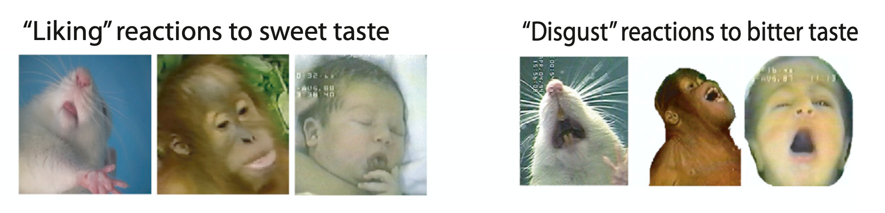
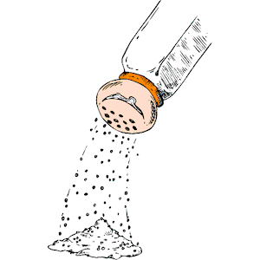
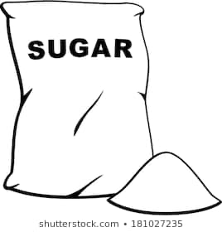
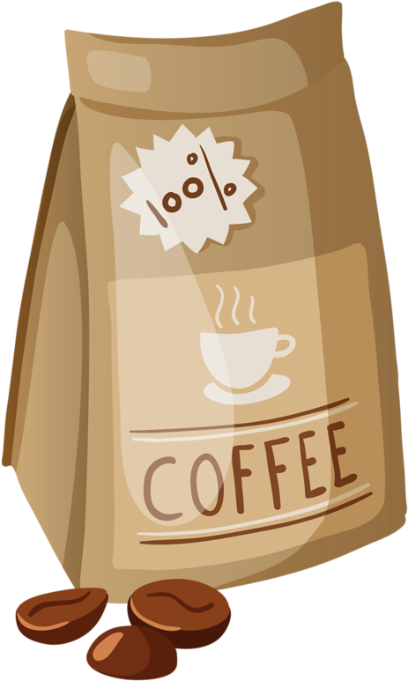
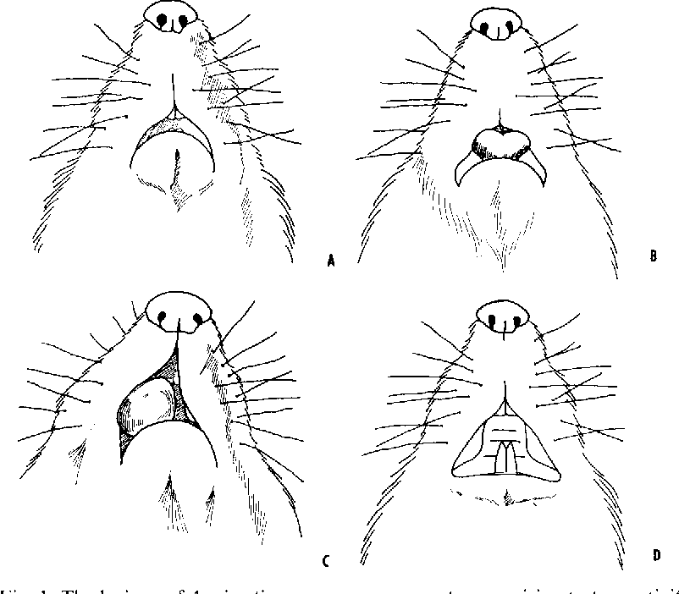
What is this “taste reactivity” paradigm?
QUININE
TASTANTS
SUCROSE
REACTION
(Berridge, 2015)
(Grill & Norgren, Brain Research 1978)
Notes:
so taste reactivity is a method of studying and measuring responses to tastant stimuli
*CLICK*
A tastant, either something bitter, sweet, salty, etc, is injected directly into the oral cavity of a mouse--->And behavioral responses are analyzed in turn
Tastants produce highly stereotyped, innate behavior, and theres clear linkage to affective state.
*CLICK*
For example this schematic drawn by Harvey Grill and others in the late 70’s shows these stereotyped responses in mice, from licking (which is appetitive) and Gaping (which eludes to aversion).
Now to add to how stereotyped these behaviors are, they’re seen across species.
*CLICK*
so here is another graphic from Kent Berridge showing these same responses in human infants and primates.
These two studies catalyzed the field of taste reactivity. However, theres the added confound of human subjectivity in scoring certain behaviors, which leads to difficulties in reproducing published work.

Slide 7
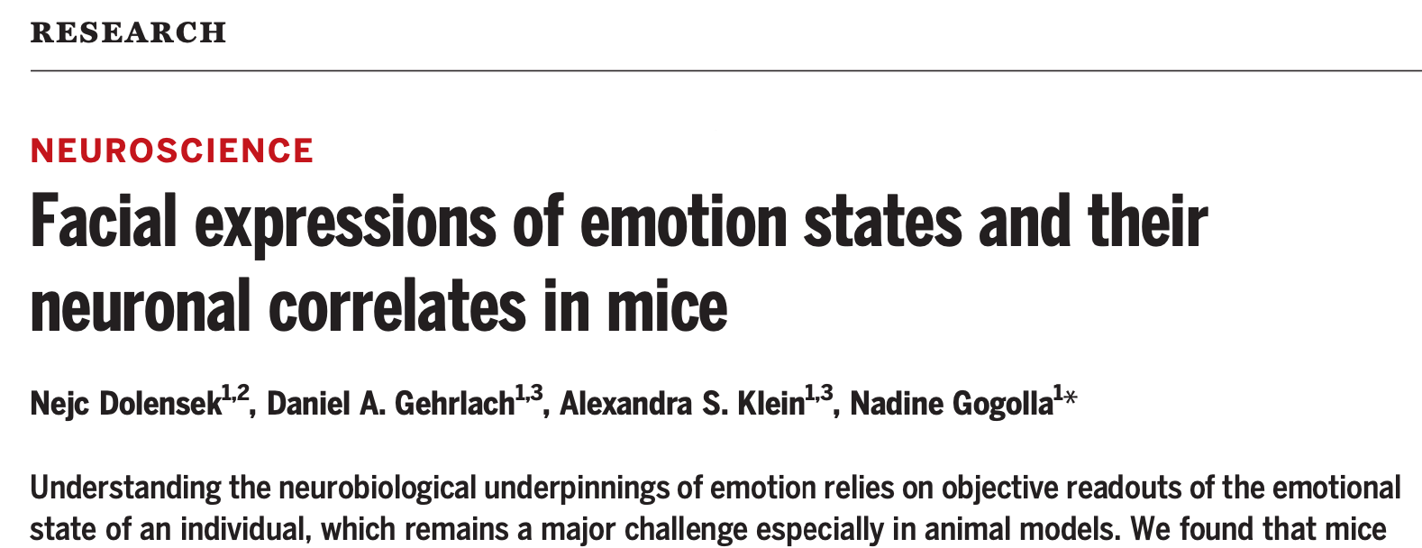
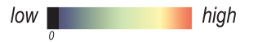
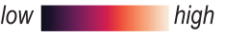
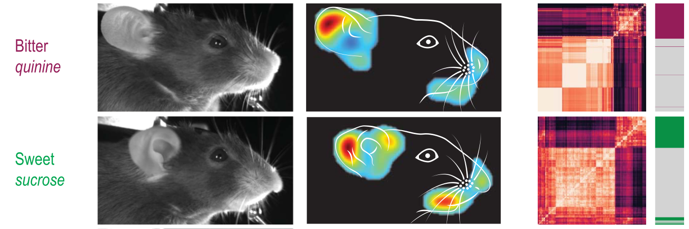
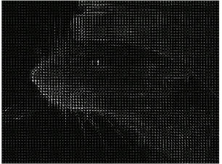
What behaviors drive this?
HOG (Histogram of Oriented Gradients) vector
analysis
Representative Single Frame
Difference from baseline
HOG Correlation
Notes:
To combat this more recently, Nadine Gogolla has automated this paradigm
*click*
through unsupervised HOG vector analysis, which analyses facial changes in response to the same stimuli mentioned, based off of change in pixel contrast. You can see the severity of change also overlaid on the cartoon image, and subsequent correlation maps to the right.
So again, this reignited the need to automate the scoring procedure of taste reactivity. However, the downside into this approach is the inability to pull out SPECIFIC features governing their correlation mapping. As in, we know vaguely there's substantial changes in the mouth area for sucrose, lets say,
*click*
but what parts of the face are changing? Is it tongue protrusions? Is it the opening and closing of the mouth?
So we still want more contextual information about the nuances of reactivity.

Slide 8
Broad Questions
Can we replicate past literature?
And if so, can we quantify these behaviors with different machine vision approaches?
AIM 1:
automate scoring of previous data (gaping, licking, etc) and assess through python machine learning (ML)
AIM 2:
How does ML classification change as the internal state changes?
AIM 3:
Feature Importance
Notes:
so this all brought about some broader questions for this quarter
in particular *CLICK*
whether we can replicate past literature that use the same tastants of sucrose and quinine ?
*CLICK*
and if so can we quantify these behaviors through machine learning techniques?
*CLICK*
So we attempted to first automate the scoring process of previous data (so trying to quantify gaping and licking behaviors) (tackling reproducibility) and assessment through python.
*CLICK*
We also wanted to see how this assessment changes as the homeostatic state changes in mice.
*CLICK*
And then through that, we can pick out the most important features that distinguish these opposing stimuli from each other (which adds more context for taste reactivity)

Slide 9
Experiment

Slide 10

Experimental Timeline
Day 0
habituation
n=5 WT mice, within design
session duration: 1hr
Day 15:
Injection with furosemide,
A diurectic agent
Day 15
baseline state
Day 17
deplete state
Day 19
replete state
Notes:
Wild-type mice were recorded responding to different tastants across different internal states
*CLICK*
they were habituated for 15 days prior to recording at three homeostatic states: *CLICK*
Starting at baseline (normal homeostatic demand state, aversion to high salt molarity).
to monitor the shifts in homeostatic state, we used salt depletion so
*CLICK*
Following baseline mice were injected with furosemide, which is like a water pill to make sure you aren’t absorbing salt from the diet by frequent urination)
*CLICK*
depleted (which is depleted sodium from diet, salt is appetitive now.)
*CLICK*
then repleted (reintroduction of high Molarity salt, salt is now aversive again)
Each day has 60 trial periods per mouse, and each trial period has a two second infusion, and are alternated between the three tastants equally

Slide 11
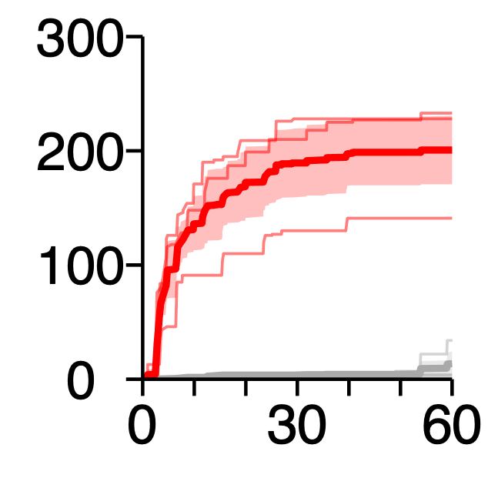
How do we monitor homeostatic shifts in reactivity?
depleted
Cumulative licks
for 0.5 M NaCl
control
time (min)
Notes:
heres just evidence of salt being pleasurable/rewarding after sodium depletion. Mice are more inclined to lick after sodium deprivation than before
So it's clear that salt is a powerful tool that allows us to study homeostatic shifts in demand for certain tastants very easily. So we’ll use it as a marker for state changes.

Slide 12
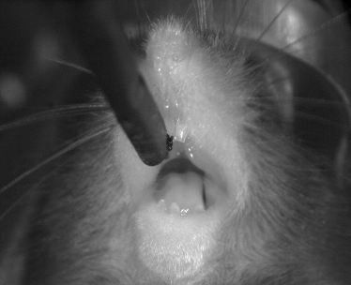
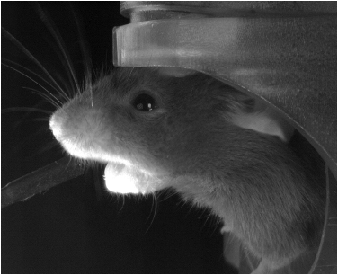
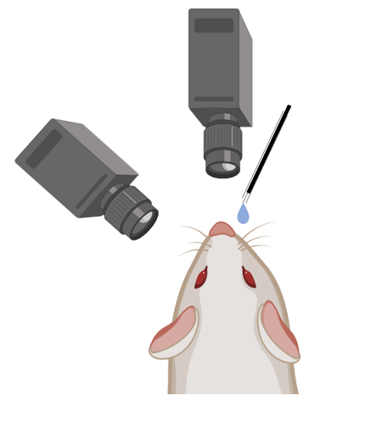

Video Acquisition
Oral view
Side profile view
60 trials/mouse/day
Tastants administered for 2s
Alternated delivery
Equal probability
Tastant spout
Image acquisition:
fps: 25
exposure: 3 or 4 ms
4s prior to infusion onset
8s following infusion onset
Total images in set: ~270,000!
Head ring
implant
Notes:
we imaged from two perspectives (with the oral view being the traditional “grill” view of taste reactivity and the profile view being the newer “gogolla” view). We recorded at 25 frames per second and had upwards of 270,000 frames to work with
And Mice were fitted for a head ring to allow for two-photon imaging eventually.

Slide 13
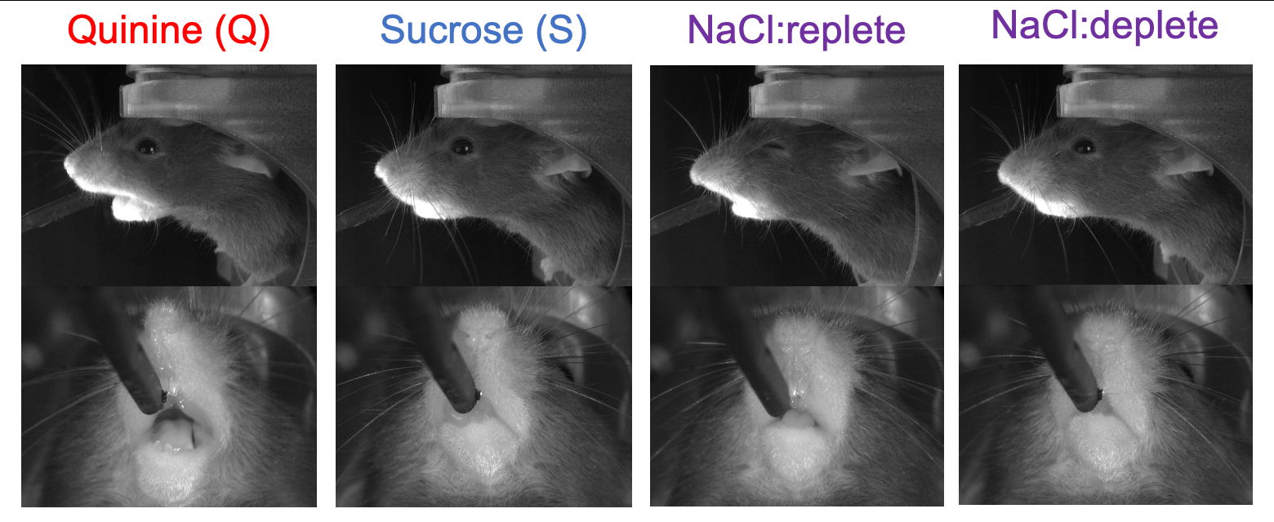
Hypothesis: features associated with sucrose and quinine responses should change in classification with demand for salt
GAPING
LICKING
GAPING
LICKING
Notes:
This lead to our hypothesis that features associated with sucrose and quinine should change in classification as dietary sodium levels change
So we’ll use sucrose and quinine as two poles of taste reactivity, and we’ll see how salt fall into that spectrum.

Slide 14
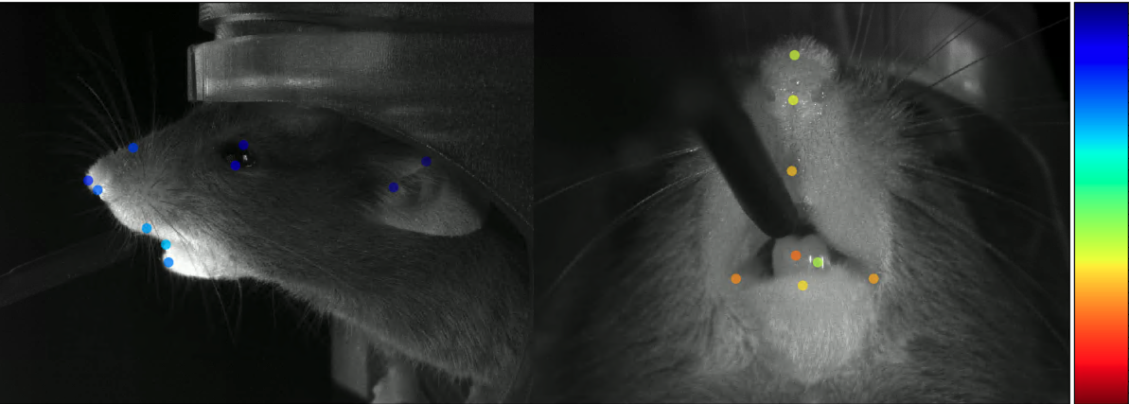
To contribute to this hypothesis:
Used DeepLabCut to track
and train model
Scored video data
Built Classifier and
analyzed performance
ears
eyes
nose tip
nose bulge
nose septum
top mouth
bottom mouth
teeth
nose tip
top mouth
bottom mouth
right corner
left corner
tongue
Notes:
So to investigate this hypothesis:
I used deeplabcut, which is a semi-supervised 3D pose estimation algorithm, to track motor movements and train a model for this existing data to reveal features that might be important to classify each emotional state automatically.
*CLICK*
I subsequently scored our video data through DLC and built a classifier to assess the training performance

Slide 15
Aim 1
automate scoring of previous data (gaping, licking, etc) and assess through python machine learning

Slide 16
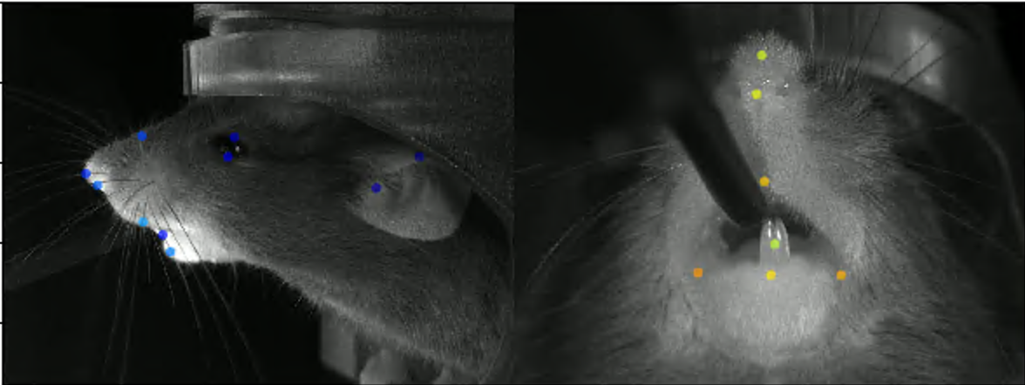
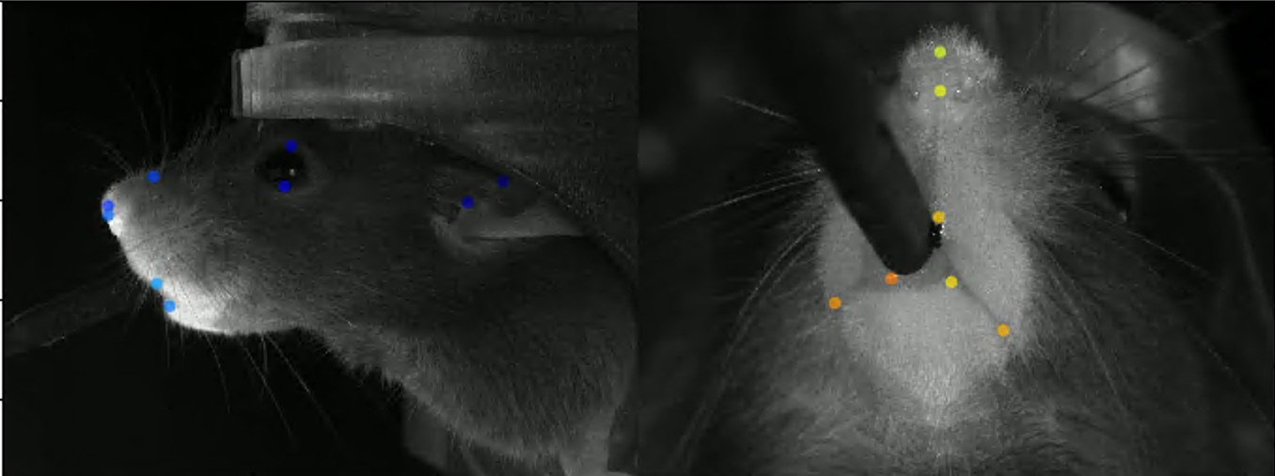
With DeepLabCut:
Gaping behavior,
quinine-like
Licking behavior,
sucrose-like
AIM 1
Notes:
To go back to Grill’s illustration, these are labeled snapshots from DLC.
with gaping and licking behaviors being very dramatic and consistent, we were able to replicate past literature with new approaches.
Something else to note is that the addition of this side profile, from the Gogolla approach, allows us to study grimmace data, as well as ear movement and nose bulging

Slide 17
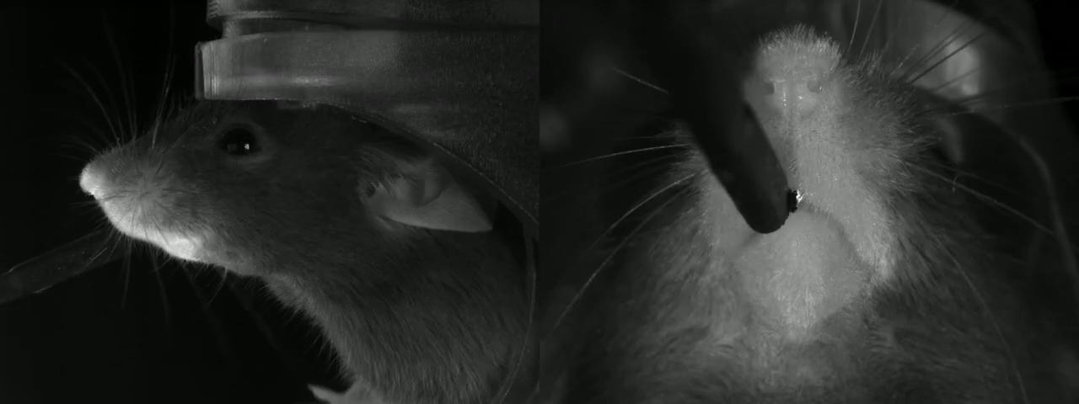

DeepLabCut can automatically track reactivity behavior
AIM 1
AIM 1
Notes:
click
So deeplabcut did a pretty decent job in tracking. These two videos are the same.
By eye you see examples of licking, so it’ll be interesting to see how this behavior is automatically classified, and whether it predicts this as sucrose like or quinine like

Slide 18
Through Python ML
QUININE?
SUCROSE?
AIM 1
AIM 1
Notes:
Next through classification, I wanted to see whether we can actually classify these two tastants?
*CLICK*

Slide 19
ML Classification workflow:
Setup Foundation
Each perspective is treated as one mouse w/ independent markers from the other
2. Collect Features
Position/time data→ Target data→ features for classification
3. Split data
80/20 split of training data and testing data
4. Training
80% sucrose quinine trials & repeated for 100 iterations
5. Test
Test accuracy of 20% sucrose/quinine test data → tastant scale
AIM 1
AIM 1
Notes:
So for some workflow transparency
*CLICK*
I’ve treated each profile as a mouse with independent labels
*CLICK*
Deeplabcut generated x and y position data over the time course for each trial and subject, so i used those as features for classification.
*CLICK*
I subsequently split data 80/20
With 80% being for training sucrose and quinine trials across subjects and 20% testing on unseen sucrose and quinine data.

Slide 20
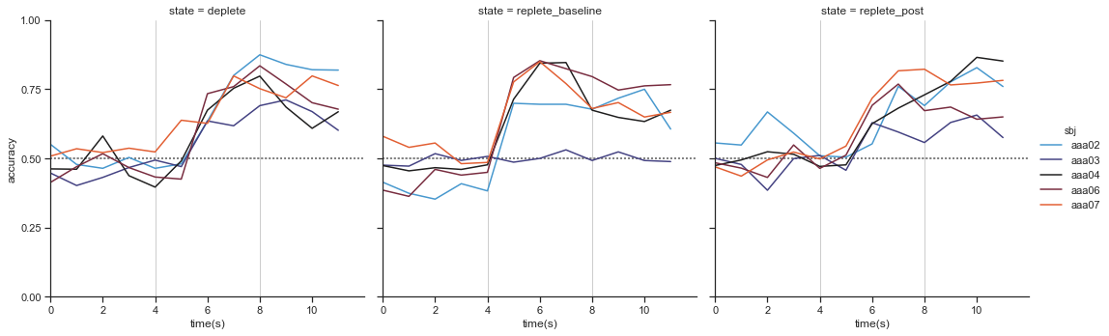
Extra-Trees Classification was the best
n=5
baseline
deplete
replete
sucrose/quinine prediction accuracy
tastant
delivery period
time relative to delivery (s)
AIM 1
Notes:
So i ran a gamut of classifiers and chose Extra Trees Classification to show for the rest of the talk. Extra Trees also has a faster execution time and averages over decision trees to avoid over-fitting.
So here I plotted accuracy.
you can see that during the time of administration,
*click*
indicated by the vertical lines at 4 and 8 seconds, theres a sharp increase in accuracy, around ~75%, and its sustained for the rest of the 12 second recording.
you can also see that its varies between subject, with some mice being classified more accurately than others.

Slide 21
Aim 2
How does classification change as the internal state changes?

Slide 22
Through Python ML
QUININE?
SUCROSE?
Salt at baseline/
deplete/replete?
Salt at baseline/
deplete/replete?
Salt at baseline/
deplete/replete?
AIM 2
Notes:
So, i wanted to see
*CLICK*
Where salt fell on the scale of sucrose and quinine?
So, I used the sodium trials as test data to see where it fell on the scale of sucrose and quinine for each subject/trial

Slide 23
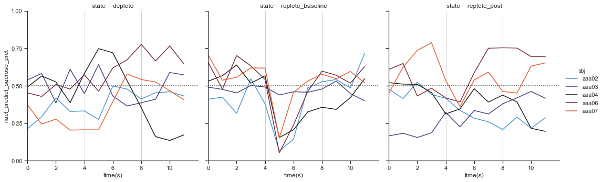
Is salt more sucrose-like or quinine-like by state?
n=5
baseline
deplete
replete
SUCROSE-LIKE
SUCROSE-LIKE
SUCROSE-LIKE
SUCROSE-LIKE
SUCROSE-LIKE
SUCROSE-LIKE
probability sucrose/quinine-like
QUININE-LIKE
QUININE-LIKE
QUININE-LIKE
QUININE-LIKE
QUININE-LIKE
QUININE-LIKE
time relative to delivery (s)
AIM 2
Notes:
So what we see here is that for baseline, salt is being classified as more quinine like (below 50%, which is threshold), so more aversive like we thought. But with deplete and replete states we see that it’s a tad more unclear as to how the classifier is classifying salt
this was seen pretty consistently for the other classifiers I ran so to gain a better picture

Slide 24
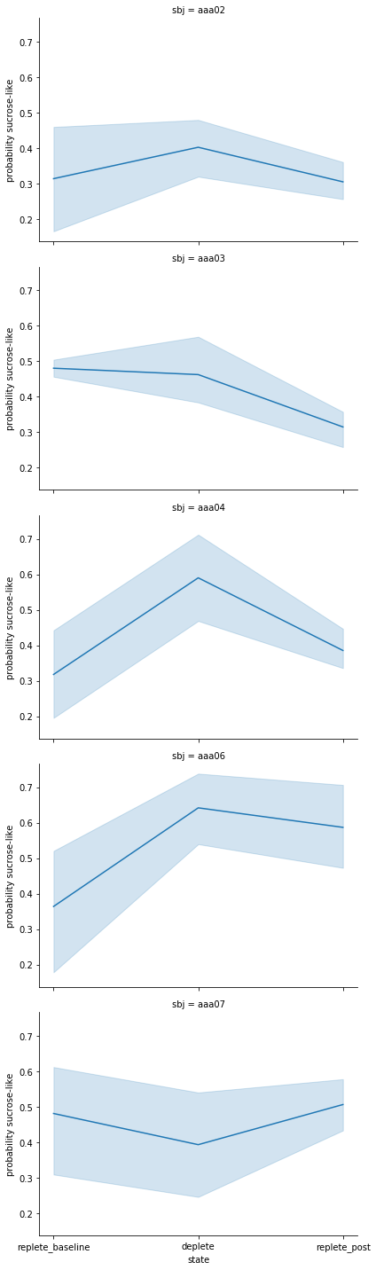
Is salt more sucrose-like or quinine-like by subject?
subject 4
#2
#6
SUCROSE-LIKE
0.5
probability sucrose/quinine-like
#3
#7
QUININE-LIKE
baseline
deplete
replete
Homeostatic state
AIM 2
Notes:
I wanted to see what was happening on a subject by subject bases.
I binned my time to encompass only the delivery window (0-4 seconds after tastant delivery).
with the same threshold in mind at 50%
*USE POINTER*
we see the trend that we were hypothesizing originally with
salt, at baseline, having a higher probability of being more quinine like,
then a shift with depleted states being more sucrose-like,
and then another shift at repleted states being more quinine-like.
*CLICK*
This trend was seen with 4 out of the 5 subjects, with 1 out of 5 displaying a reverse trend.
(This might be dependent on that subjects baseline since we still see a shift across homeostatic states, but its flipped)

Slide 25
Aim 3
Feature importance

Slide 26
Through Python ML
HOW?
QUININE?
SUCROSE?
Salt at baseline/ replete
Salt at baseline/
deplete/replete?
Salt at deplete
AIM 3
Notes:
i wanted to figure out how the classifier was classifying these tastants in general

Slide 27
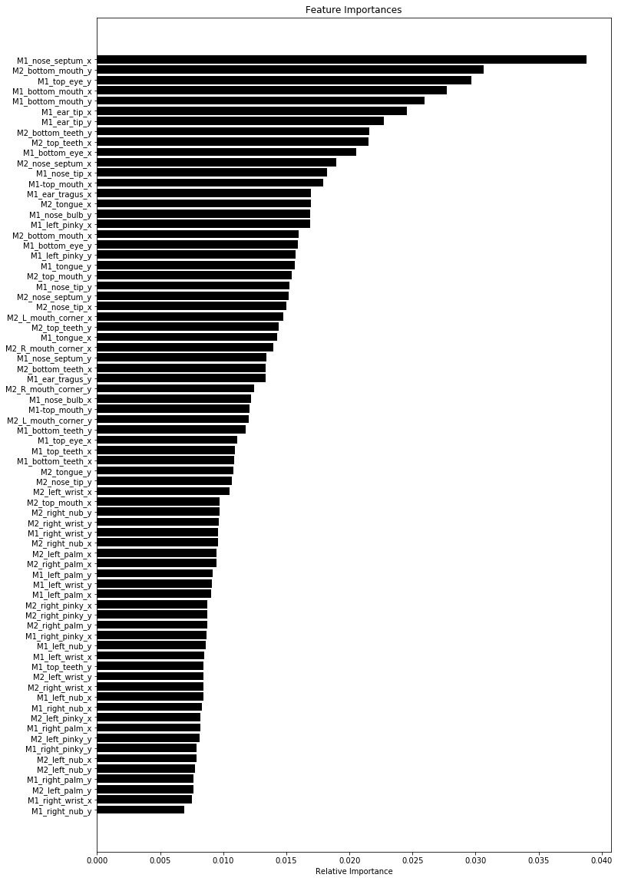
Mouth/facial motor responses govern classification
(side) nose septum (x)
(side) bottom mouth (y)
(side) top eye (x)
(oral) bottom mouth (x)
(oral) bottom teeth (x)
(side) ear tip (y)
(side) ear tip (x)
(oral) bottom teeth (y)
(oral) top teeth (x)
(side) bottom eye (x)
(oral) nose septum (x)
(oral) nose tip (x)
(side) top mouth (x)
(side) ear tragus (x)
(oral) tongue (x)
(side) nose bulb (y)
(side) left pinky (x)
(side) bottom mouth (x)
(side) bottom eye (y)
(oral) tongue (x)
Features
Relative feature importance (permutations)
AIM 3
Notes:
So I investigated across all trials of sucrose, quinine, and salt delivery, with the same time binning mentioned.
I calculated across all 74 features we collected and found that
*CLICK*
Both perspectives contributed almost equally towards importance for the first 20 features shown, with the top 10 being influenced by mouth and nose movement and teeth presence.
Each weight given to each feature is in respect to the most important feature’s weight
I also did this for each tastant individually and saw a similar feature trend.

Slide 28
Conclusions

Slide 29
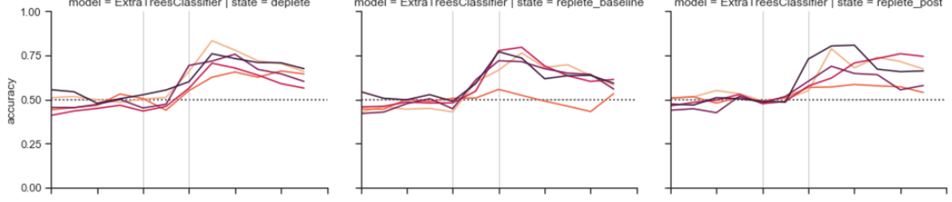
Accomplishments:
We can automate the scoring and assessment of taste reactivity videos through deeplabcut and ML
We can distinguish which features are of importance through classifying
The Gogolla approach performed similarly for extra trees (not showing all data)
baseline
deplete
replete
prediction accuracy
time relative to delivery (s)
Notes:
So some takeaways
We accomplished the automation of scoring and assessment of prior data AND utilized a different ML approach to
pull out relevant features for classification and ALSO are able to analyze SPECIFIC features over the time course if we choose.
And we compared it to the gogolla approach of HOG vector analysis and it was similar in accuracy, with the disadvantage of easily pulling out feature importance (I’m not showing all data associated with this to be considerate of time.)

Slide 30
Further Potential Directions:
If the model is decent, now there’s something that can automatically score data related to taste reactivity SO LONG AS the video recording process is standardized
Comparing it to manual scoring on the same data
Use 2P Imaging in tandem reactivity to see relationship between affective states and LHA activity
stimulation of LH via GABA and Glut expressing cells to see which populations contribute to consuming behavior and cell dynamics during it
Notes:
So to gloss over this,
We hope to implement this DLC model on future data generated from the lab and also compare to manual scoring of the same data
And eventually we hope to use two-photon imaging with photostimulation of glutamate and GABA cells in the lateral hypothalamus to have cortical context for the reactivity behaviors we see

Slide 31
Other notes
when classifying behaviors, we saw a 15% decrease in classification across each classifier when looking at each profile separately, which alludes to the need of both perspectives to make accurate classification of behaviors associated with sucrose responses and quinine responses.
despite the decrease in performance, didn’t lead to a shift in features important for classification, meaning behaviors associated with mouth orientation are still the dominant determinant of classification
Also, change in position over time enhances classification of sucrose and quinine by ~2%, so its consistent at least with just running classification on position/time
87.6 % of all high likelihood trials has paws present at high probability
Features are pretty consistent for subject and tastants individually
Notes:
Interestingly enough, when classifying behaviors in this separated manner, we saw a 15% decrease in classification across each classifier, which alludes to the need of both perspectives to make accurate classification of behaviors associated with sucrose responses and quinine responses.
However, despite the decrease in performance, this discovery didn’t lead to a shift in features important for classification, meaning behaviors associated with mouth orientation are still the dominant determinant of classification.

Slide 32

Acknowledgments
The Stuber Lab
The Golden Lab
UW Center of Excellence in Neurobiology of Addiction, Pain, and Emotion (NAPE)
The Graduate Program!
THANKS!!

Slide 33
Relevant Background Papers referenced (in order)
Chen BT, Yau HJ, Hatch C, Kusumoto-Yoshida I, Cho SL, Hopf FW, Bonci A. Rescuing cocaine-induced prefrontal cortex hypoactivity prevents compulsive cocaine seeking. Nature. 2013 Apr 18;496(7445):359-62. doi: 10.1038/nature12024. Epub 2013 Apr 3. PMID: 23552889.
Grill HJ, Norgren R. The taste reactivity test. I. Mimetic responses to gustatory stimuli in neurologically normal rats. Brain Res. 1978 Mar 24;143(2):263-79. doi: 10.1016/0006-8993(78)90568-1. PMID: 630409.
Berridge KC, Kringelbach ML. Pleasure systems in the brain. Neuron. 2015 May 6;86(3):646-64. doi: 10.1016/j.neuron.2015.02.018. PMID: 25950633; PMCID: PMC4425246.
Dolensek N, Gehrlach DA, Klein AS, Gogolla N. Facial expressions of emotion states and their neuronal correlates in mice. Science. 2020 Apr 3;368(6486):89-94. doi: 10.1126/science.aaz9468. PMID: 32241948.
Oka, Y., Butnaru, M., von Buchholtz, L. et al. High salt recruits aversive taste pathways. Nature 494, 472–475 (2013). https://doi.org/10.1038/nature11905

Slide 34
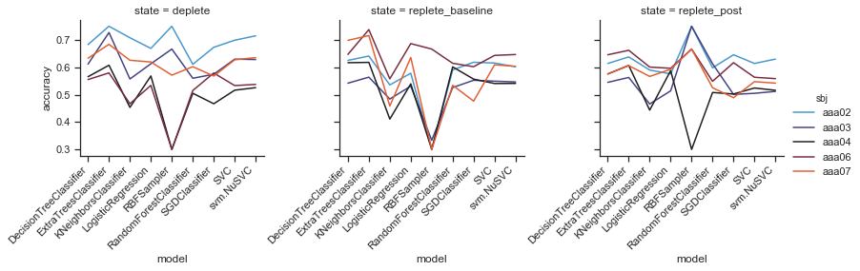

Slide 35
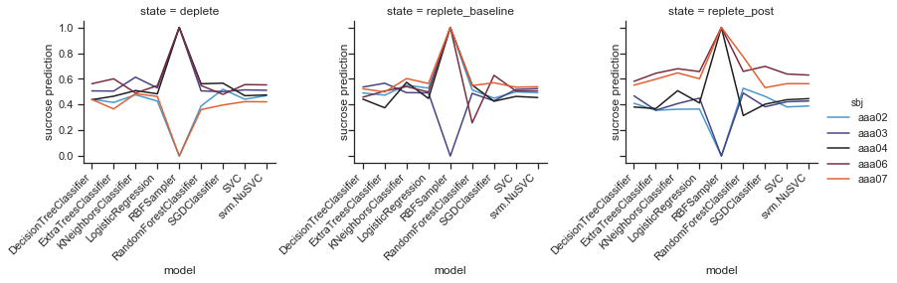

Slide 36
